Slide 1
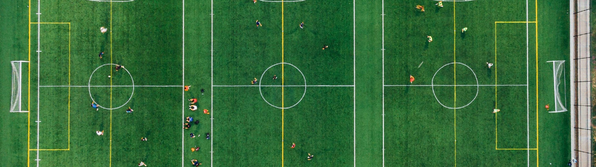


2024 AGM
Huntsville Soccer Club
Annual General Meeting
January 8, 2024
7:00pm

Slide 2
Welcome
Welcome to the Huntsville Soccer Club’s Virtual Annual General Meeting!
Call to order.
Notice was provided in accordance with our Bylaws.
Roll Call (including proxies).
Confirm that quorum (which is 10 regular members) has been met.
We therefore have a validly constituted meeting and can proceed with tonight’s business.
First order of business: approve last year’s minutes.
Approval of Agenda.

Slide 3
Acknowledgement
We will begin this AGM by acknowledging that we are meeting (and indeed play soccer) on land that has been inhabited by Indigenous Peoples from the beginning. In particular, we acknowledge the traditional territory of the Ojibway, Chippewa and Algonquin peoples. We recognize and deeply appreciate their historic connection to this place. We also recognize the contributions First Nations, Metis, Inuit and other Indigenous Peoples have made, both in shaping and strengthening this community in particular, and our province and country as a whole.

Slide 4

Agenda
Club Executive
President’s Report
Report re MUFC
ONCA
Minor Soccer Report
U8 Development Report
Adult Coordinator Report
Women’s Coordinator Report
Head Referee Report
Treasurer Report; Financial Audit; Auditor
2024 Club and Team Sponsors
Election
2025 Club Sponsors
Q&A

Slide 5
Club Executive
The Huntsville Soccer Club executive board consists of several voting and non-voting positions.
Every two years, half of our voting positions come up for re-election.
Below are our voting positions on the board:
*** Positions open for re-election are
* D&I Officer and Rep Coordinator roles to be removed from the board
Up for re-election |  | Second of a two year term
President | Ted Maduri | Vice President | Chris Occhiuzzi
Head Referee | Glen Duffield | Treasurer | Anne McNally
Secretary | Marlon Jordan | Adult Coordinator | Melanie Mercier
Womens Director | Mike Hill | Minor Coordinator | Kayla Bauer

Slide 6
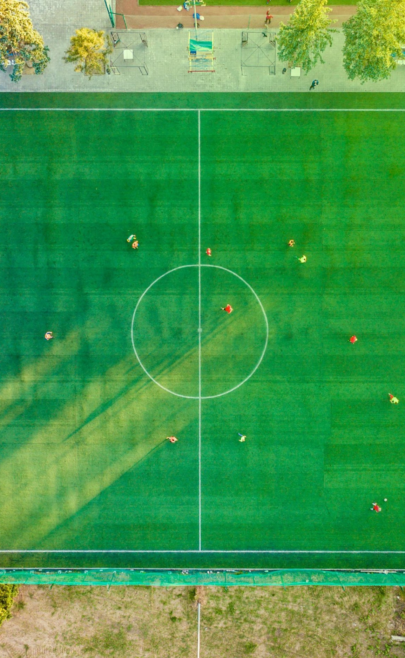
2. President’s Report
HIGHLIGHTS
Virtually sold out across the board in Youth programming: Summer, Fall and Winter
Adult: strong numbers plus new programming (Men’s Only Pick Up- Mondays at 7pm and Men’s Open Age Select Team )
Women’s League
Soccer day was the best I’ve seen
U8 Development: ~ 30 participants
Great volunteers in all areas
Amazing Club (and other) sponsors
Continued cooperation and coordination with BSC
Administrator: one for all three clubs–sign of things to come

Slide 7

2. President’s Report (cont’d)
FUTURE CHALLENGES (Immediate and Long-term)
Minor Soccer: service offering, coordinators and leader
Treasurer
Facilities: grass and gym space
Sponsors: future club sponsors aren’t guaranteed and are hugely important
Changing of the guard

Slide 8






3. Report re: MUFC
Recall MUFC is a separate legal entity. It is “owned” by HSC and BSC.
It is run by a board of 8 individuals: 4 nominees from HSC and 4 nominees from BSC.
Nominees from HSC are Steph N, Glen D, Chris O, Chuck L and Ted M
Milestone: 2024 was the first year that MUFC ran the Development Program.
This past year we had 276 players and 17 teams between U9 - U21 Divisions
We had 16 of the 17 teams compete in the HDSL and one team compete in OWSL
This upcoming year, we hope to have X rep teams in the following age groups:
[Laura to insert details]
Huge thank you to our club and team sponsors:

Slide 9
3. President’s Report re MUFC (Cont’d)
Some good improvements this year such as:
  development teams and time with Coach Ray (both direct and indirect),
  some goalie training,
  partnership with SportLab and strength and conditioning.
  Overall, the work and cooperation between the two clubs has been incredible.
But….growing pains still exist:
  fees (in both directions);
  level of competition (is good enough, not good enough?);
  communication (never good enough);
  volunteer burnout.
It takes so much time to have 3 boards to run soccer in Huntsville and Bracebridge; likely not sustainable. Merger: inevitable?
Thanks to all the coaches, board members and other volunteers for the countless hours.

Slide 10








MUFC Development Team Sponsors 2024

Slide 11






MUFC Rep Team Sponsors 2024

Slide 12





MUFC Rep Team Sponsors 2024 (Cont’d)

Slide 13
4. ONCA

Slide 14
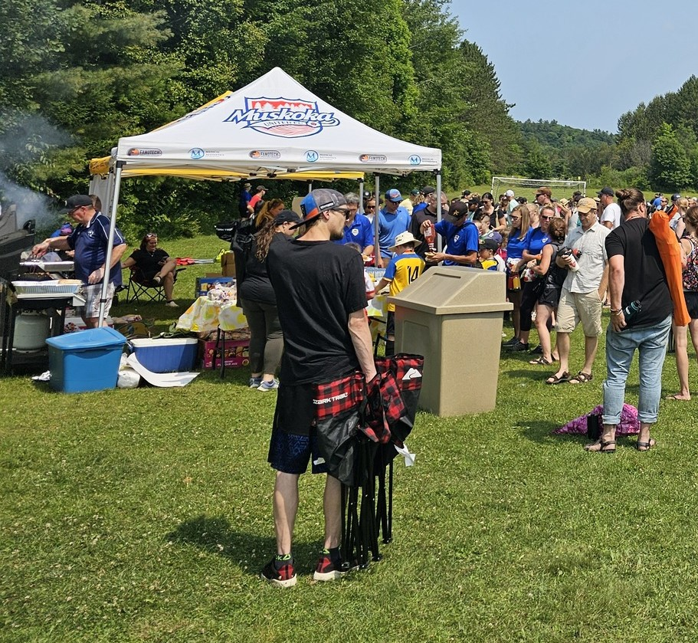
5. Minor Soccer Report (cont’d)
Soccer day was held on Saturday July 27th
  Bullock’s Independant donated all the food for BBQ - $483 raised and donated to Huntsville Hospital’s MRI fund
  Sue Morrison donated freezies
  We also had games, additional displays (MUFC team fundraisers, etc)
Challenger Sports Camp ran July 29th to August 2nd at McCulley North Fields
Registrations for Summer Camp (TOTAL = 61):
  Tiny Tikes =2
  Half Day = 16
  Full Day = 43
A HUGE thank you to all the volunteers that made house league and soccer day a success!

Slide 15
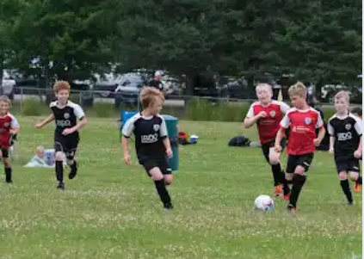
5. Minor Soccer Report
Number of Winter (Indoor) Youth players = 54
  43 Boys, 11 Girls
Number of Summer Youth House League players = 526
  U4 = 62
  U6 girls = 56; U6 boys = 75
  U8 girls = 43; U8 boys = 90
  U10 girls = 39; U10 boys = 68
  U12 girls = 30; U12 boys = 41
  U15 co-ed = 22
Number of Fall League players = 101
Total players = 681
Two Program Coordinators were hired to run the house league programs; big thanks to them. Hiring already for next year!

Slide 16
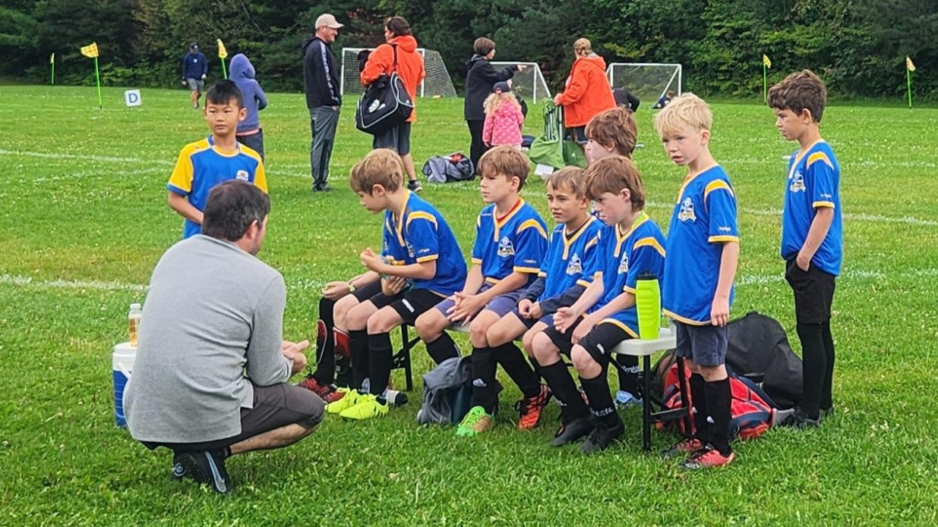
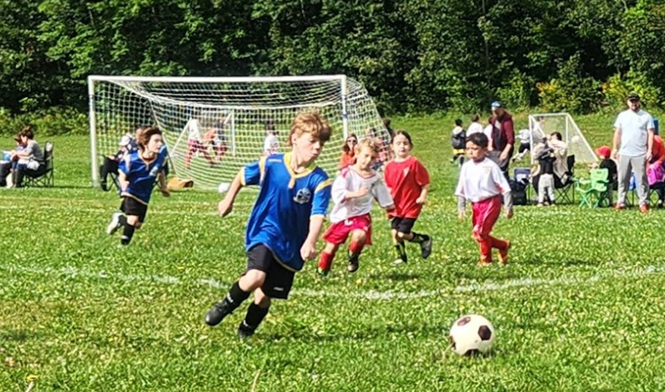
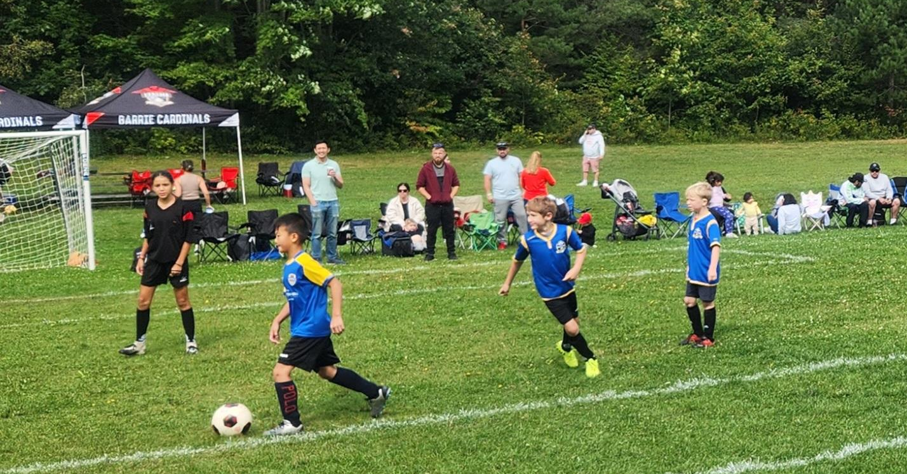
6. U8 Development Program
U8 Development Program = 30
Big thanks to Andrew MacDonald and Steph Nasturzio
Combination of 2016 and 2017 born players, girls & boys
Program ran from May 24th to August 25th
Attended Three U8 Festivals with 2 teams attending each festival in Orillia, Innisfil and Huntsville.

Slide 17
7. Adult Coordinator Report
Programs | Registrations | Dates
Women’s 7v7 League | 40 | May-July
Indoor Rec & Co-ed Pick-up Leagues | 68 | November - April
Outdoor Experienced Co-ed League | 72 | May - August
Outdoor Intermediate Co-ed 7v7 League | 21 | May - August
Sunday Morning Only Co-ed Rec Pick up | 11 | May - October
Men’s Team | 16 | May - July
Men’s Only Pickup (New) | 21 | May - October
Carlos Burmeister Memorial Tournament | 50 | Sat, Sept 14th
Adult Coordinator: Melanie Mercier / Assistant: George Johns

Slide 18
6. Adult Coordinator Report (cont’d)
2023/24 Indoor Season
Tuesday Experienced Division One League- 6-10pm HHS Gym C. Three, One hour time slots for games. 6 teams of 6-7 players. Started the season first week of November, played pick up until the Holiday break in an effort to assist with fair team building to begin the new year. Well attended.
Thursday Intermediate Division Two Pick up- 8-10pm HHS GYM C- Low registration numbers but consistent turn out each week.
Thursday Adult Teams Only Pick up- New* 8-10pm HHS GYM AB- Well attended. Competitive.
2024 Outdoor Season- MCCulley Fields.
Intermediate Division Two Pick up - Wednesdays @ 7pm. 7v7 format reflected registration interest. Consistent turnout each week. Had some welcome late registrations to boost numbers. Finished 10 week season with pizza and positive feedback. All games were officiated.
Experienced Division One League- Thursdays @ 7pm. 4 Teams of 15- 16 players. Once again started the season with an Introduction night of pick up games where players could meet/re-unite and coordinators could assess skill to assist in team organizing prior to season start. Competitive season with more carded fouls/incidents and suspensions than in previous years. Lower registration numbers a concern, very few under age 30. All games had a Referee and 1 or 2 Assistant Referees. Field Conditions were poor and responsible for unnecessary play errors and increased risk of injury to players. Town is working on improving it.

Slide 19
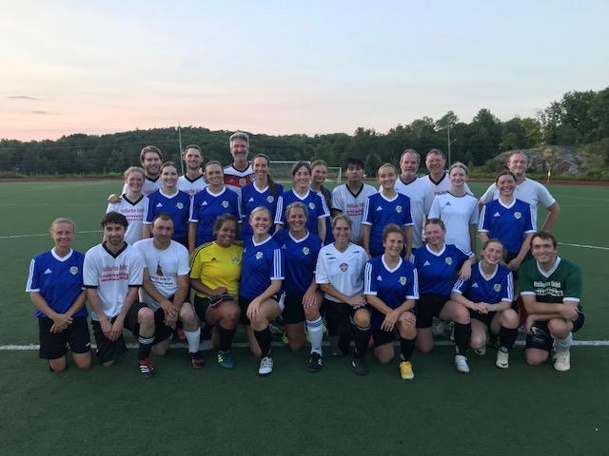
7. Adult Coordinator Report (cont’d)
New* Men’s Only Pick Up- Mondays at 7pm, May-October. Well attended. Mix of drills, pick-up
games and friendlies with other HSC teams. Growing interest and will return in 2025.
Sunday Only- 10am, pickup at Conroy and McCulley. Numbers dropped significantly this year. Sundays were offered as a complimentary add-on to league registrations. Not officiated.
New* Men’s Open Age Select Team - Select Competitive Recreational travelling team 19+. Played in friendlies with neighbouring towns and a tournament in Kinston. Of to a great start, hopeful to join a league this coming season in North Bay or Barrie.
Carlos Tournament - Saturday September 14th, 7v7, Conroy Park, 2 fields, 50 players, 5 teams of 10. Pizza, prizes, music. Smaller registration numbers and slightly less money raised but still an excellent day with great weather. (Thanks Carlos!)

Slide 20
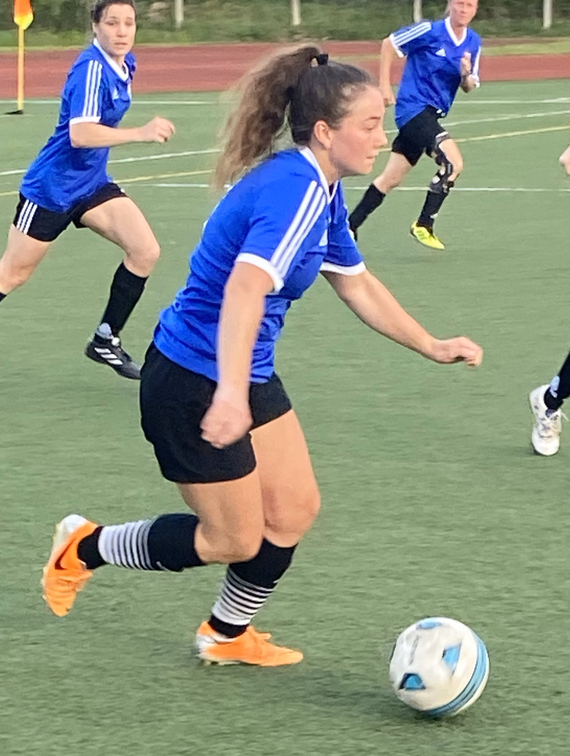
8. Women’s Coordinator Report
2024 marked the second successful season of the Huntsville Women Only Soccer League.
The Women’s League was made up of four teams of 12 players each, 48 registered players in total, competing weekly in a 7v7 format.
Rules and field dimensions were modified to accommodate this format.
The season was played over ten weeks with each team competing in eleven games and a champion crowned at the completion.

Slide 21
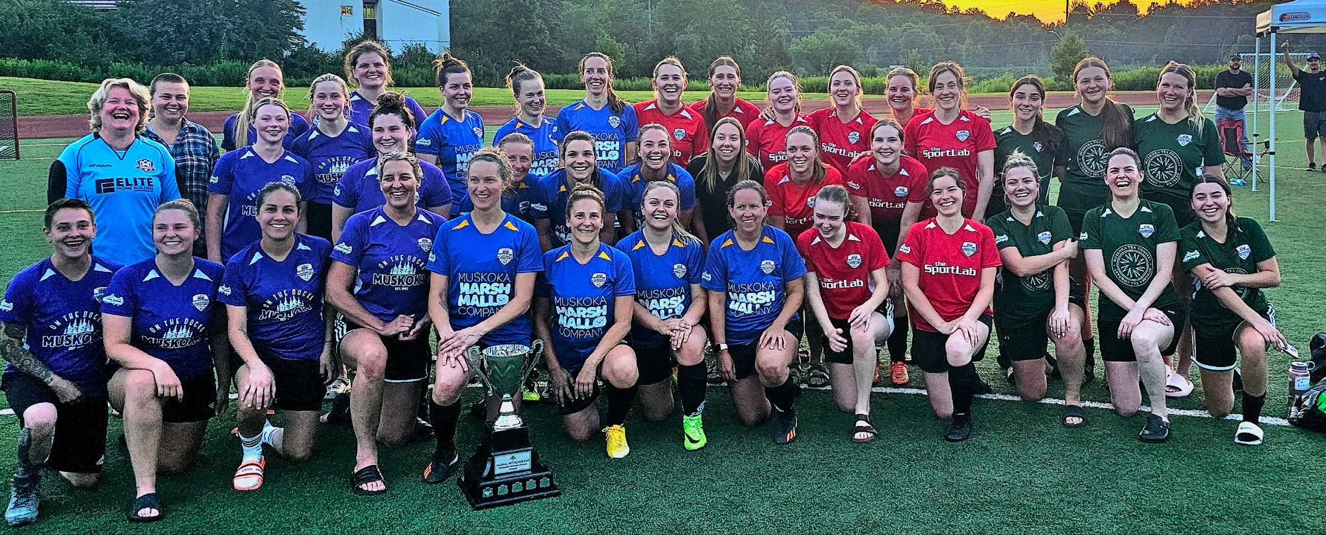
Through the help of HSC, we again this year, secured 4 team sponsors, all locally owned and operated business’ as well as 2 other contributors to help offset the cost of uniforms, prizes and the year-end champions trophy.
A suggestions for improvement is altering field dimensions to make the pitch larger in hopes that this will minimize the rash of contact injuries we saw this year.
Huntsville FC est. 2016, made up of advanced adult female players, continued their successful run. Weekly training throughout the winter and summer months proves highly beneficial to the overall improvement of skill level and team comradery.
The Women’s Coordinator provides a ‘voice’ for our female members and all have been encouraged to contribute their thoughts and suggestions through me, for action by HSC.

Slide 22

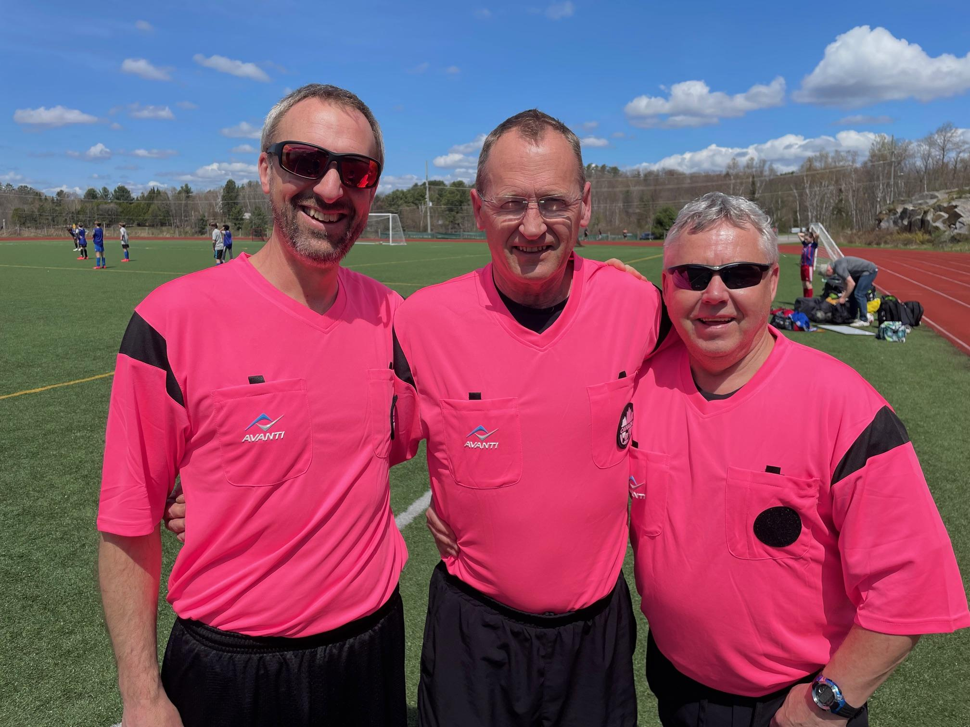
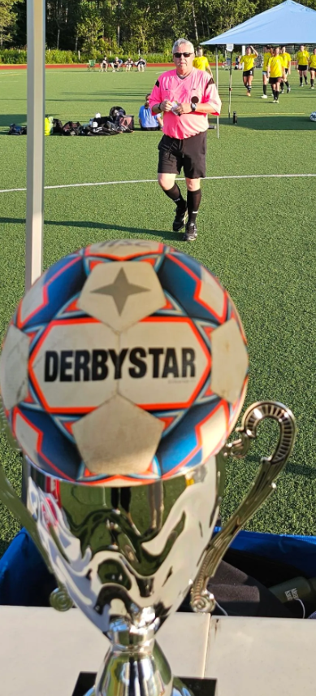
9. Head Referee Report
In 2024, the Huntsville Soccer Club had a total of 13 Match Officials who were either returning from last season or newly signed up through the online Ontario
Soccer Association Referee Course.
Our soccer season ran from May 20th to
August 25th, 2024 with a total of 196 games
including the popular House League Soccer Day,
the Carlos Burmeister Invitational tournament and
HDSA U8 Festival.
In addition to this total, are 82 competitive games
for Muskoka United Football Club, a continued collaboration between Huntsville and Bracebridge.
Match Officials at Conroy Park
Jez Bell, Mike Hill & Glen Duffield

Slide 23

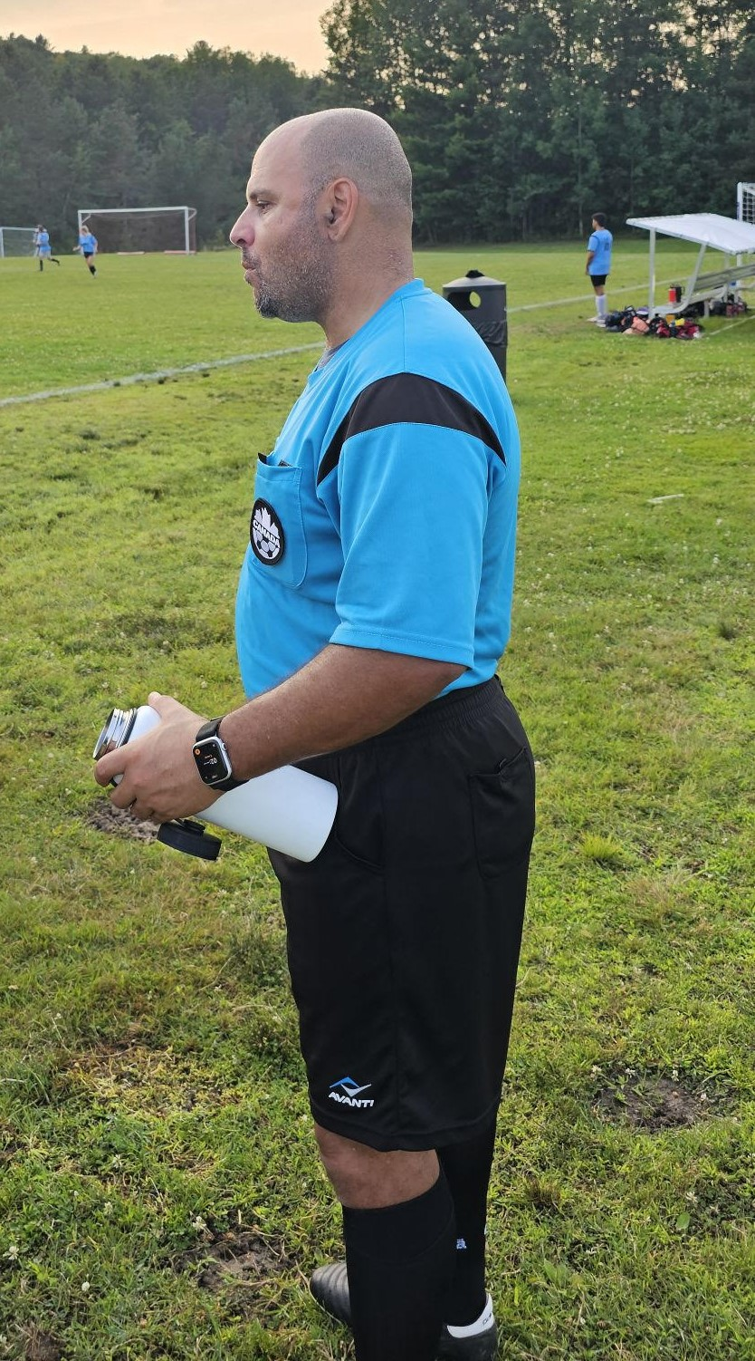
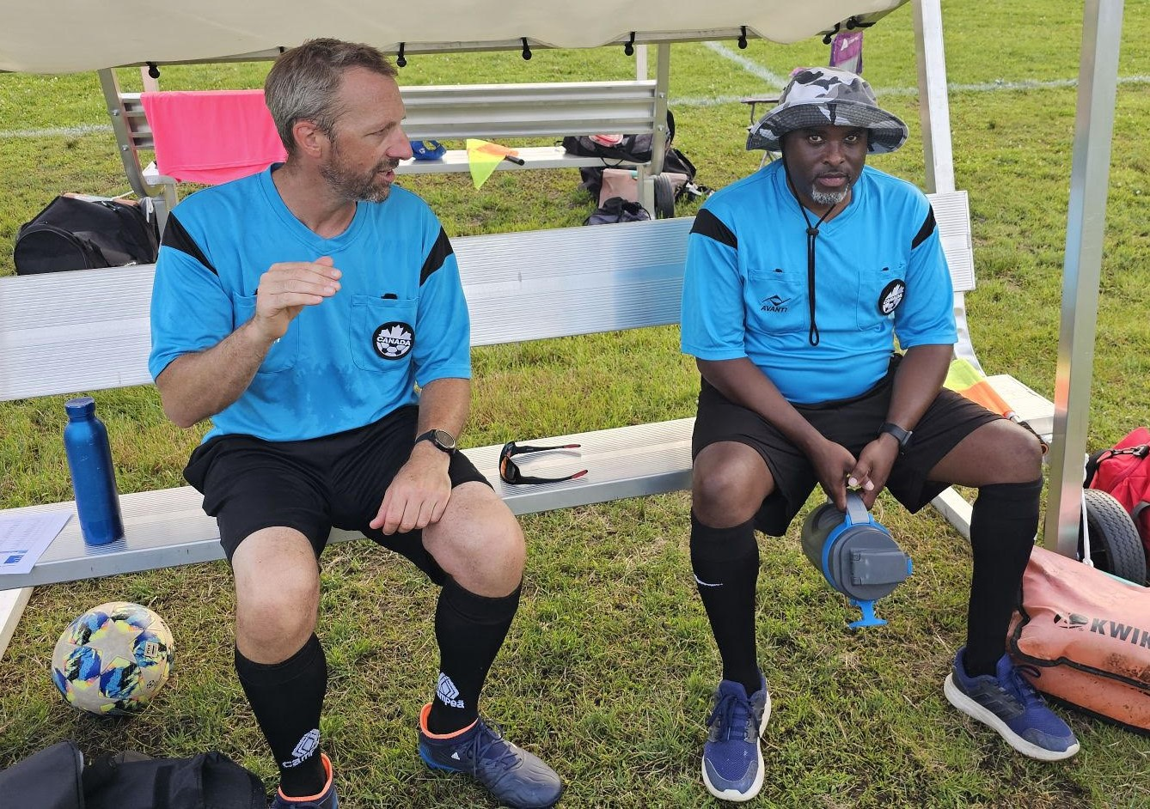
9. Head Referee Report (cont’d)
We were extremely successful in filling our match official assignments for 2024
(Ref and A/R’s, a rate of 98.7%)
Huntsville SC is always interested in bringing along new referees through our in-house mentor program, please contact us through our website to register for 2025.
in game analysis
Jez Bell & Marlon Jordan
New Match Official
Steve Abouldahab

Slide 24
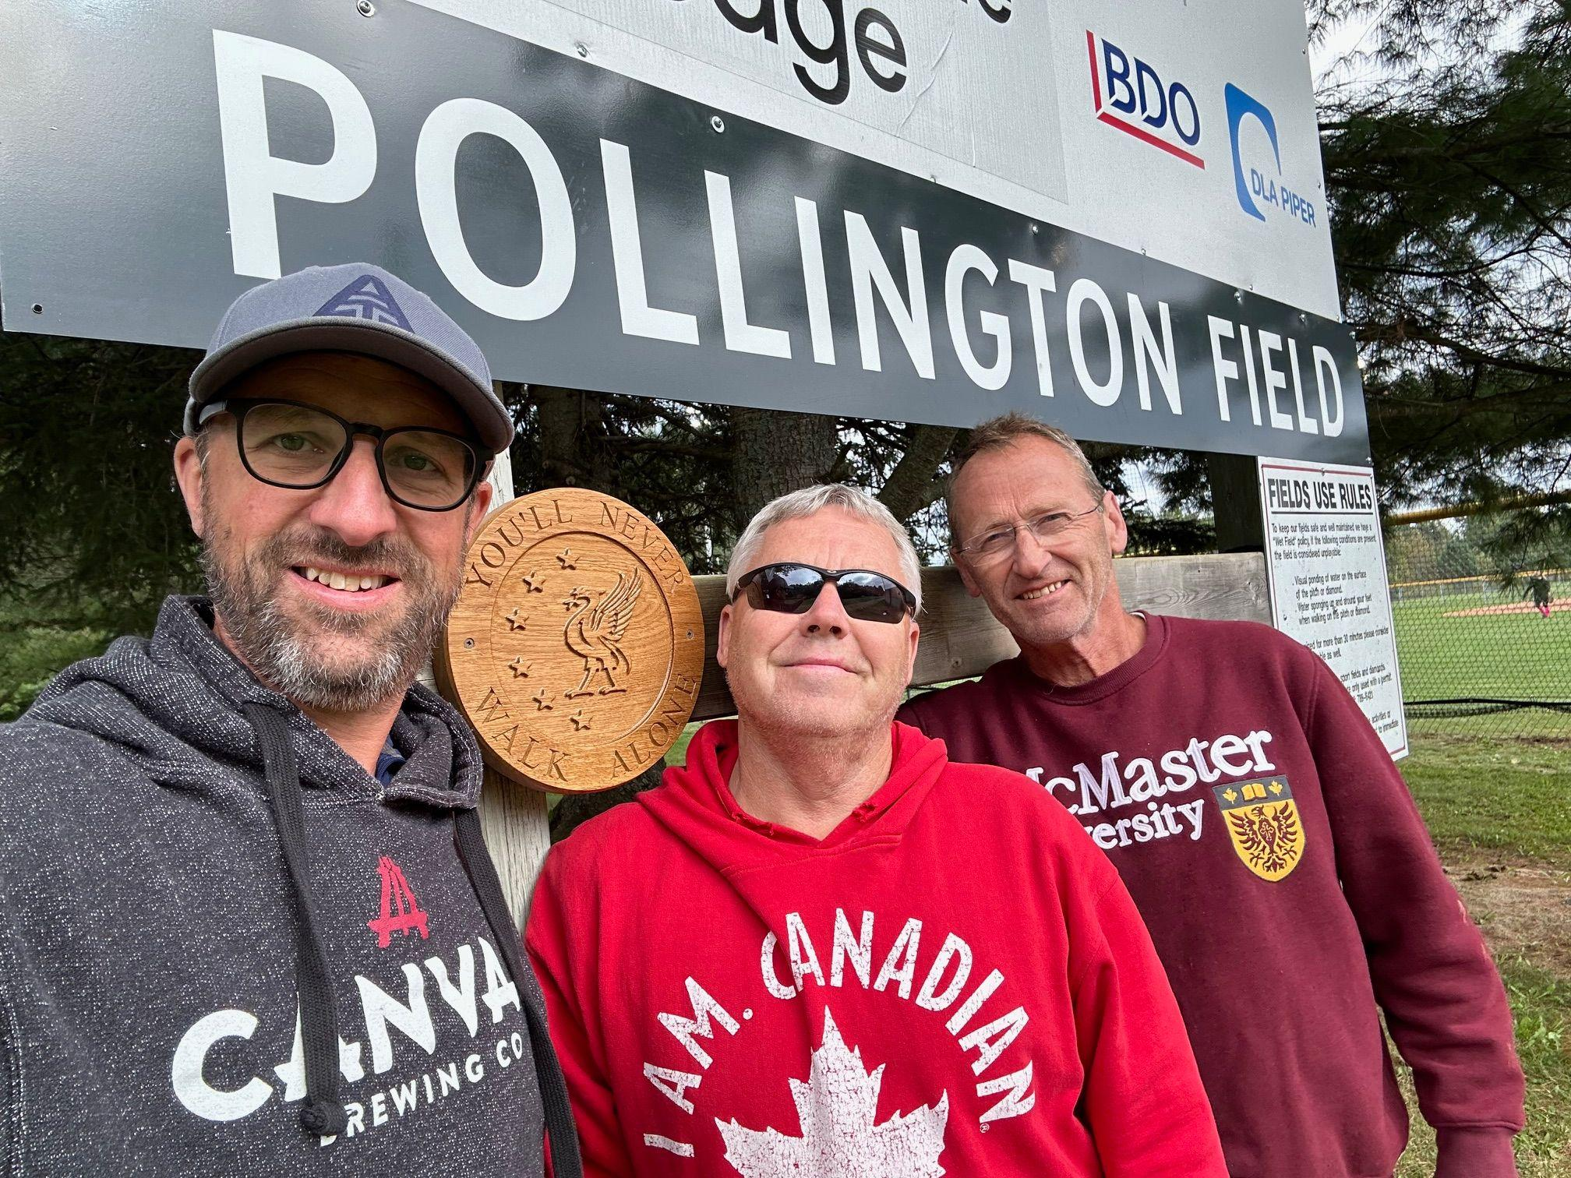
9. Head Referee Report (cont’d)
Pollington Field
In August 2024, the new sign was installed at the McCulley Robertson North Fields in memory and to honour our late friend and former match official, Graham Pollington.
The official celebration and grand opening of Pollington Field will be held at a later date (likely in the spring of 2025), so we can enjoy a game of football in his honour afterwards.
RIP Graham, YNWA…….
Fellow Referees Jez, Glen & Mike pay tribute to our friend, Graham Pollington

Slide 25
10. Treasurer Report
The Club is reporting a net income of $12,700, compared to break-even last year. Interest contributed to $6,000 due to higher GIC interest rates.
Revenue has returned to $175K - in line with 2015/2016 - up $25K from last year.
Rep - extra teams increased revenue, however Rep made a loss due to purchase of new balls and extra uniforms ordered for unregistered players.
House League
Fall program - this continued another revenue stream from Youth with great success.
Summer program - registrations for youth higher than 2022, and expansion in adult programs for Women’s League and Men’s League increased revenue and net income for the Adult program.
Indoor - revenue increased due to expansion of extra Adult teams in the league format.
Net Income was increased due to more control of costs, and accounting for overheads when setting fees for new programs. For existing programs, mainly Youth, there was again no increase in fees since 2018 even though constant pressure from third party fees / costs.
Donations
Carlos Burmeister Memorial - $2,040 in September 2023.
Huntsville Hospital Foundation - $453 - Soccer Day BBQ.
The Club continues to remain in a strong financial position with Net Assets at $267K.
House League is the ‘bread and butter’ for the Club, and even more important for the Club to take responsibility that Youth numbers continue to grow and become a feeder to MUFC for the Rep teams.
The Club will be looking to spend $25K to $35K next year on a new set of 4 goals and seating equipment for the south field next year.

Slide 26
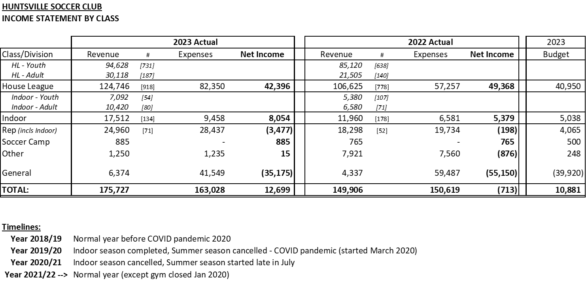

Slide 27
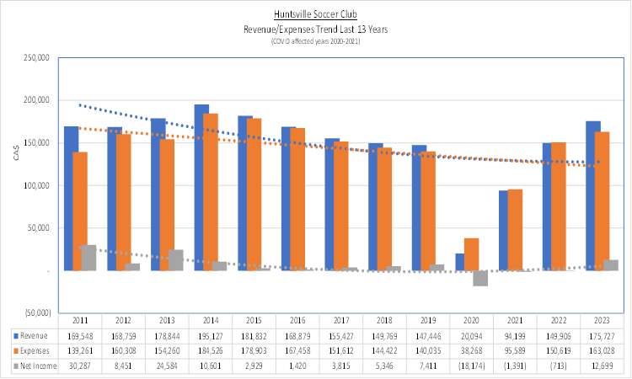

Slide 28
10. Financial Audit; Auditor
HSC has received our financial audit from BDO for the last fiscal year. Copies of the financials are
available on request.
The statement summary from BDO is as follows:
We have audited the financial statements of Huntsville Soccer Club (the Club), which comprise the statement of financial position as at August 31, 2022, the statements of operations and net assets and cash flows for the year then ended, and notes to the financial statements, including a summary of significant account policies.
In our opinion, the accompanying financial statements present fairly, in all material respects, the financial position of the Club as at August 31st, 2022, and its results of operations and its cash flows for the year then ended in accordance with Canadian accounting standards for not-for-profit organizations.
APPROVAL OF AUDITOR’S REPORT
APPOINTMENT OF AUDITOR

Slide 29




11. 2024 Club Sponsors

Slide 30







11. 2024 Adult and WL Sponsors

Slide 31







11. 2024 Adult and WL Sponsors

Slide 32
12. Tonight’s Elections
The following positions are up for election:
*Nominations can be made from the floor for position where there is no one nominated
POSITION | NOMINATED
President | Steph Nasturzio **
Head Referee | Glen Duffield **
Secretary | Marlon Jordan **
Womens Director | Mike Hill **
Treasurer: Anne McNally
**Acclaimed

Slide 33
12. Support Positions
To assist the Executive, the following positions have been created–please spread the word about these vacancies:
POSITION | VOLUNTEER
Equipment Manager | Haydn Kirby
Assistant Treasurer | Vacant
Sponsorship Manager | Dan Gibbons
Assistant Minor Soccer | Vacant
Assistant Adult Coordinator | George Johns

Slide 34
13. 2025 Club Sponsors

Slide 35
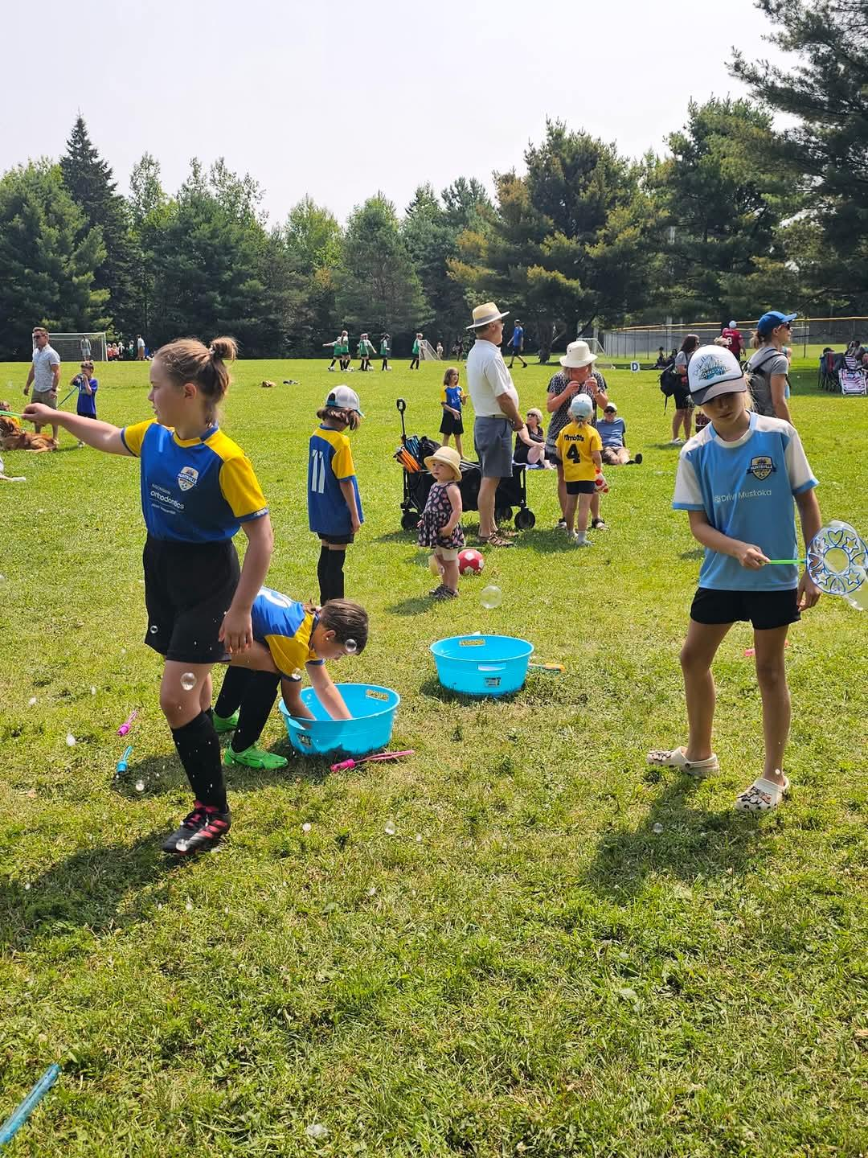
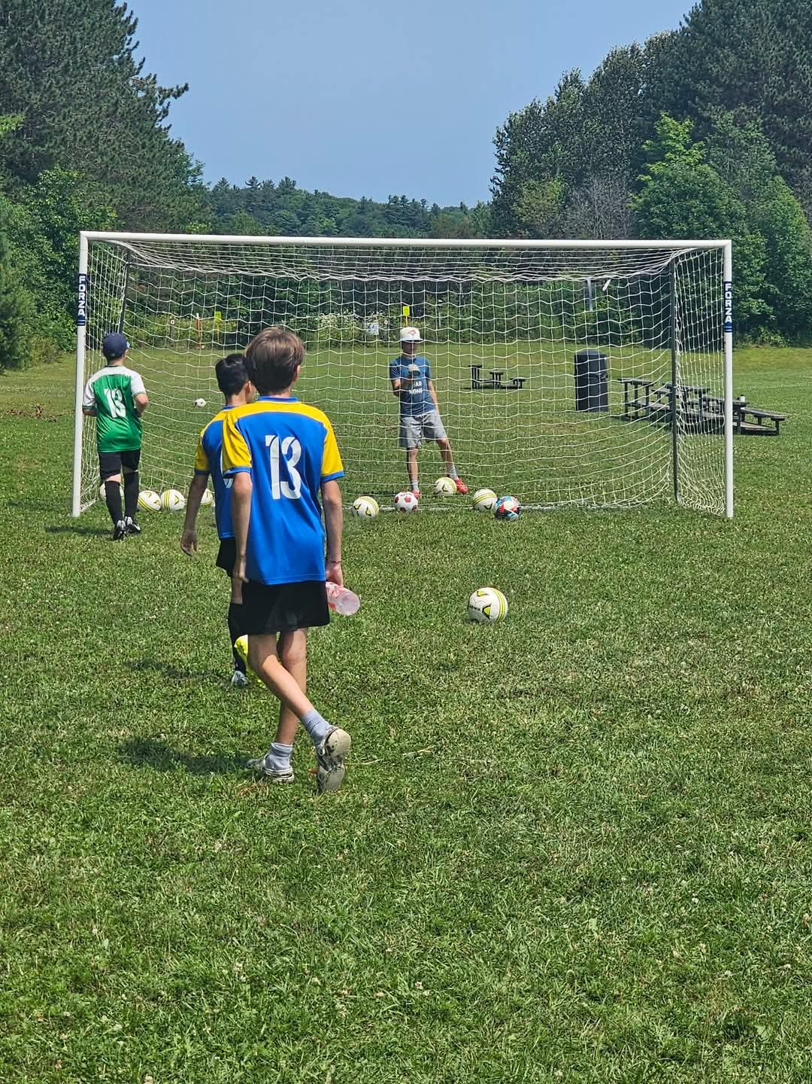
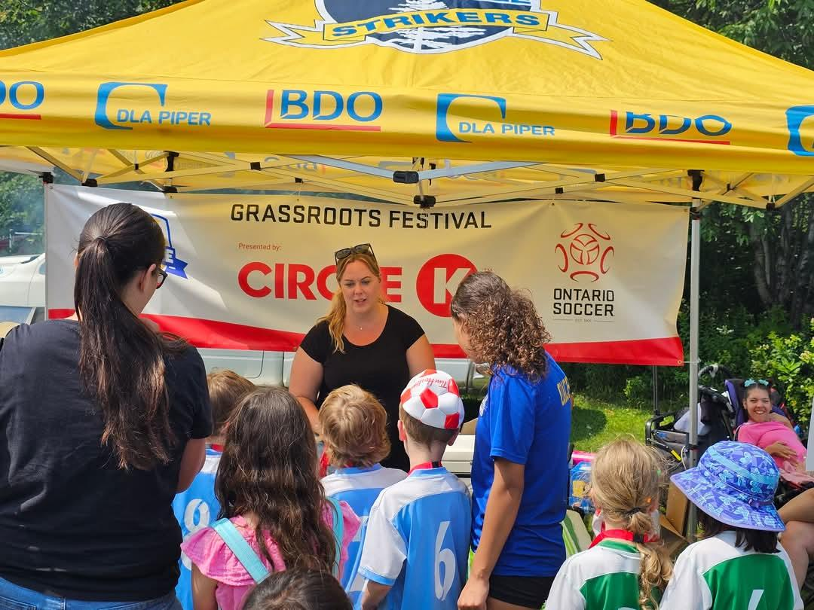
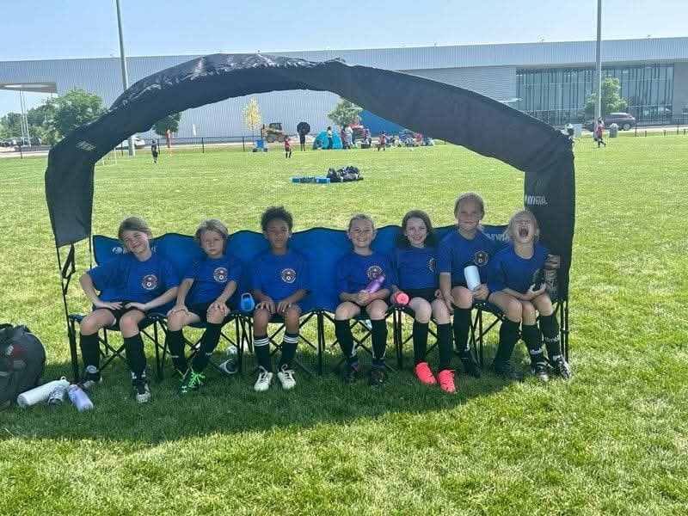
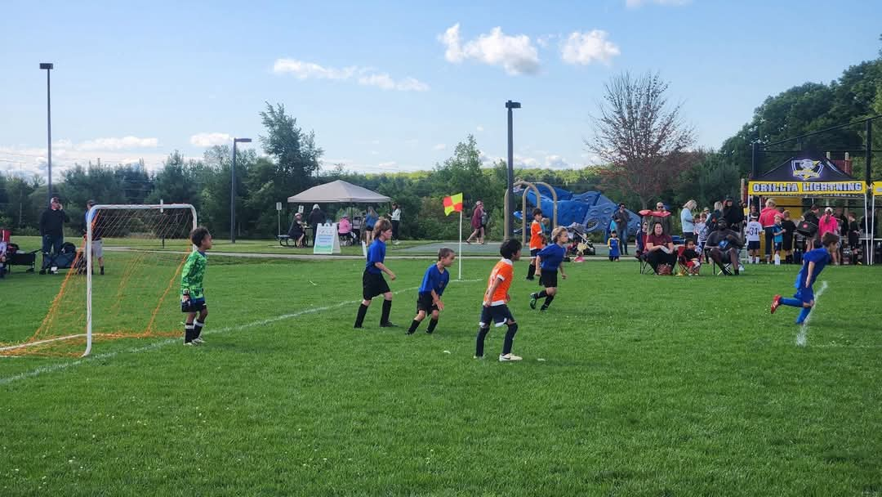
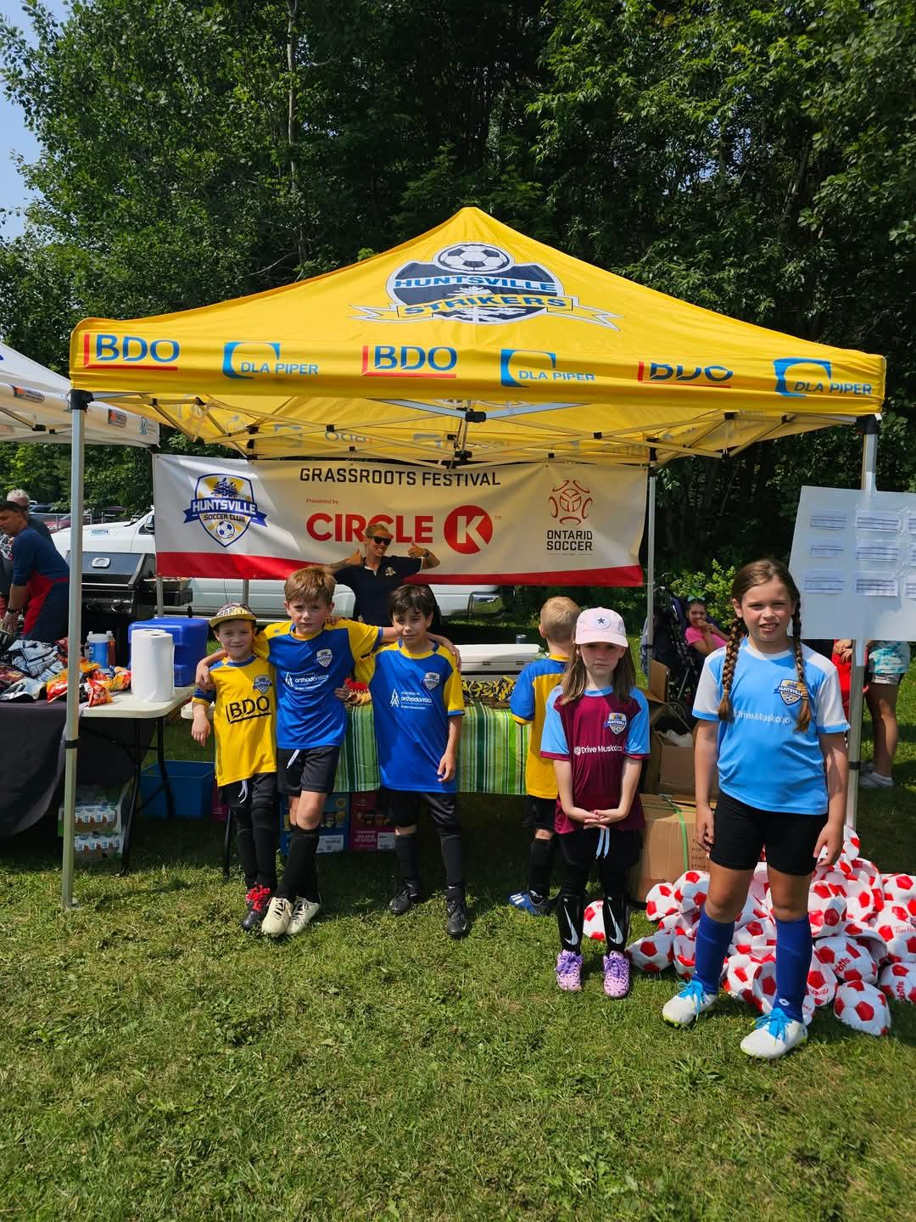
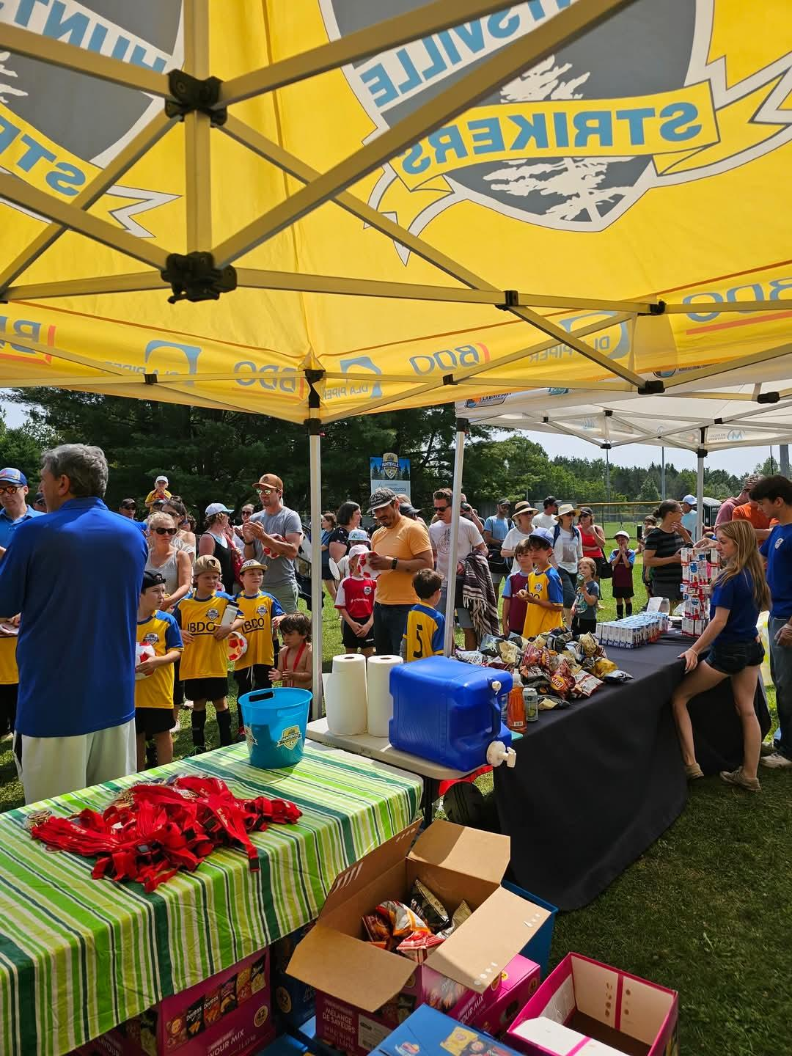
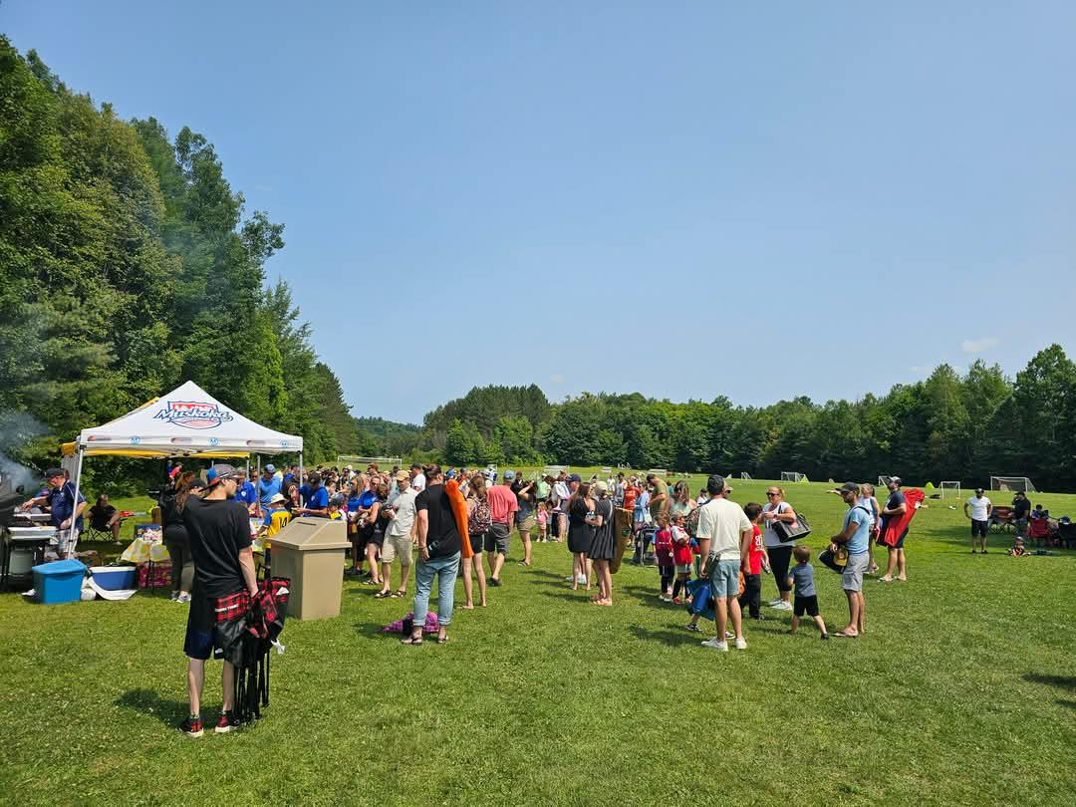
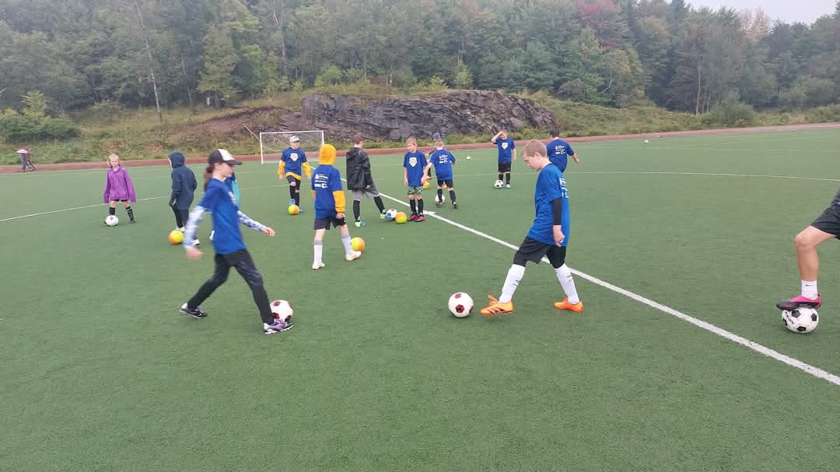
14. Q&A

